Slide 1
Software Testing

Slide 2
A Perspective on Testing

Slide 3
Why do we test?
Two primary reasons: to make a judgment about quality or acceptability, and to discover problems.
Testing is necessary because humans are fallible, particularly in the domain of software and software-controlled systems.
Purpose of Testing
Quality assessment: Assessing the quality or acceptability of the software product.
Problem discovery: Identifying and addressing issues and defects within the software.

Slide 4
Significance in Software Domain
Software and software-controlled systems are prone to errors and vulnerabilities due to their complexity.
Testing serves as a critical process to identify and rectify these errors, ensuring software reliability and functionality.
Objective of the Chapter
Establish a framework for examining software testing.
Provide a structured approach to understanding the principles and practices of software testing.

Slide 5
Basic Definitions
Complexity of Testing Terminology
Testing literature often contains confusing and inconsistent terminology.
Evolution of testing technology over decades and contributions from numerous authors contribute to this complexity.
ISTQB Glossary
The International Software Testing Qualification Board (ISTQB) offers an extensive glossary of testing terms.
ISTQB's glossary provides standardized definitions to mitigate confusion in testing terminology.

Slide 6
Compatibility with Standards
The terminology used in the syllabus, as well as in the ISTQB glossary, aligns with definitions established by the Institute of Electronics and Electrical Engineers (IEEE) Computer Society.
Progression of Terms
The syllabus offers a useful progression of terms to facilitate understanding and navigation through testing concepts and principles.

Slide 7
Error
Definition: Errors are human actions that result in deviation from intended behavior or specification.
Example: A programmer mistakenly writes incorrect code that causes the software to crash when certain inputs are provided.
Synonym: Mistake

Slide 8
Bug
Definition: Bugs are errors in software code resulting from human mistakes during programming.
Example: The software fails to execute a specific function as intended due to an error in the code, resulting in unexpected behavior.
Relation to Error: Errors in coding are often referred to as bugs, reflecting the unintentional deviation from desired functionality.

Slide 9
Fault
Definition: A fault represents an error in the software system. It is the manifestation or expression of an error, conveyed through various modes of expression such as narrative text, diagrams, charts, and source code.
Synonyms: Defect, Bug
Example: In a software application, a fault may be evident in the source code as a logical error that causes the program to produce incorrect outputs.
Elusiveness of Faults
Faults can be elusive, making them challenging to detect and resolve.
Example: A subtle error in the code logic may only manifest under specific conditions or input scenarios, making it difficult to identify during testing.

Slide 10
Faults of Commission vs. Faults of Omission
Faults of Commission: Occur when incorrect information is entered into the representation.
Example: A programmer mistakenly assigns the wrong variable value in the source code, leading to a fault that causes unexpected behavior.
Faults of Omission: Occur when correct information is missing from the representation.
Example: Failure to include a necessary condition or requirement in the software design documentation results in a fault of omission.

Slide 11
Difficulty of Detecting and Resolving Faults of Omission
Faults of omission are more challenging to detect and resolve compared to faults of commission.
Example: Identifying missing requirements or specifications in the early stages of development requires thorough analysis and collaboration among stakeholders.

Slide 12
Failure
Definition: A failure occurs when the code associated with a fault executes, resulting in observable deviations from the expected behavior of the software.
Example: When a user inputs certain data into the software, and the program crashes or produces incorrect output due to a fault in the code, a failure occurs.

Slide 13
Subtleties of Failure
Failures are observed in executable representations, typically source code or loaded object code.
Failures are directly linked to faults of commission, where incorrect information is present in the representation.

Slide 14
Challenges with Faults of Omission
Failures resulting from faults of omission pose challenges as they involve missing or incomplete information in the representation.
Example: If a critical requirement is omitted from the software design documentation, it may lead to a failure when the software is executed in real-world scenarios.
Addressing Faults of Omission
Reviews play a crucial role in preventing failures by identifying faults, including those of omission.
Well-executed reviews have the potential to detect and address faults of omission before they lead to failures in the software.

Slide 15
Review Process
Reviews involve thorough examination and analysis of software artifacts, such as requirements documents, design specifications, and source code.
By identifying and rectifying faults early in the development process, reviews help mitigate the risk of failures in the software.

Slide 16
Incident
Definition: An incident is the symptom or observable manifestation associated with a failure that alerts the user, customer, or tester to the occurrence of the failure.
Example: In a software application, an incident could be a system crash, an error message, or unexpected behavior that indicates a failure has occurred.
Importance: Incidents serve as indicators of potential issues within the software, prompting further investigation and resolution by the development or testing team.

Slide 17
Test
Definition: A test is the process of exercising software by executing predefined test cases.
Purpose: Tests are conducted with two distinct goals:
Finding failures: Identifying errors, faults, or defects within the software that result in observable failures or incidents.
Demonstrating correct execution: Verifying that the software behaves as expected under specified conditions, indicating that it meets the desired requirements and specifications.

Slide 18
Test Case
Definition: A test case is a structured set of inputs, execution conditions, and expected outcomes designed to test a specific program behavior or functionality.
Components:
Identity: Each test case is uniquely identified to facilitate tracking and management.
Associated Program Behavior: Test cases are linked to specific program behaviors or functionalities that they aim to verify.
Inputs and Expected Outputs: Test cases include a set of inputs or stimuli and the corresponding expected outputs or responses.

Slide 19
Importance of Test Cases
Central Position in Testing: Test cases play a crucial role in the testing process, serving as the primary means to verify the correctness and reliability of software.
Testing Process Steps:
Test Planning: Involves defining objectives, selecting appropriate test cases, and outlining testing strategies.
Test Case Development: Involves creating structured test cases based on requirements and specifications.
Running Test Cases: Involves executing the test cases against the software under test to evaluate its behavior.
Evaluating Test Results: Involves analyzing the outcomes of test case executions to assess software quality and identify defects.

Slide 20
Life Cycle Model for Testing
Figure 1.1 portrays a life cycle model for testing, illustrating the various phases involved in the testing process.
Opportunities for Error: The development phases present opportunities for errors to occur, resulting in faults that may propagate through subsequent stages.
Fault Resolution: The process of resolving faults introduces additional opportunities for errors to occur, potentially leading to new defects or issues.

Slide 21
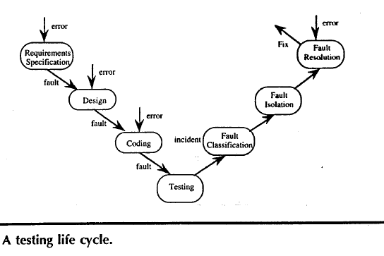
1.1

Slide 22
Test Case Essentials
Definition: A test case is a recognized work product in software testing.
Components of a Complete Test Case:
Test Case Identifier
Brief Statement of Purpose (e.g., a business rule)
Description of Preconditions
Actual Test Case Inputs
Expected Outputs
Description of Expected Postconditions
Execution History (for test management use)

Slide 23
Importance of Output
The output portion of a test case is often overlooked but is crucial, especially in complex scenarios.
Example: In testing software for determining optimal aircraft routes, defining the expected optimal route is challenging. Solutions like reference testing, involving expert judgments, can help address this challenge.

Slide 24
Test Case Execution Process
Test case execution involves several steps:
Establishing necessary preconditions
Providing test case inputs
Observing outputs
Comparing observed outputs with expected outputs
Ensuring expected postconditions exist to determine test success or failure.

Slide 25
Value of Test Cases
Test cases are as valuable as source code in the software development process.
They need to be developed, reviewed, used, managed, and saved to ensure effective testing and quality assurance.

Slide 26
Venn Diagram
Fundamental Focus of Testing
Testing is primarily concerned with behavior rather than the code-based perspective common among software developers.
Distinction: The code-based view focuses on what the software is (its structure and implementation), while the behavioral view considers what it does (its functionality and behavior).

Slide 27
Source of Difficulty for Testers
Testers often encounter challenges because the base documents, such as requirements and specifications, are typically written by and for developers.
Emphasis on Code-based Information: Base documents tend to prioritize code-based information over behavioral aspects, making it challenging for testers to derive the expected behavior solely from these documents.
Role of a Venn Diagram
A simple Venn diagram is introduced to clarify several persistent questions about testing.
The diagram helps illustrate the relationship between code-based information and behavioral aspects, providing insights into the intersection and differences between the two perspectives.

Slide 28
Universe of Program Behaviors
Testing focuses on understanding the essence of program behaviors.
Given a program and its specification, consider the set S of specified behaviors and the set P of programmed behaviors.
Relationship between Specified and Programmed Behaviors
Figure 1.2 illustrates the relationship between specified and programmed behaviors.
Specified behaviors are represented in the circle labeled S, while programmed behaviors are in circle P.
The intersection of S and P represents the "correct" portion, where behaviors are both specified and implemented.

Slide 29
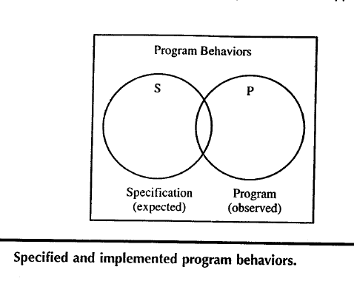
1.2

Slide 30
Challenges Confronting Testers
Testers face challenges when certain specified behaviors are not programmed (faults of omission) or when certain programmed behaviors are not specified (faults of commission).
Intersection of S and P: Represents behaviors that are both specified and implemented, which is the desired outcome of testing.
View of Testing
Testing is viewed as the determination of the extent of program behavior that is both specified and implemented.
"Correctness" is relative and depends on the alignment between specification and implementation.

Slide 31
Introduction of Test Cases
Figure 1.3 introduces a new circle representing test cases in addition to the circles for specified (S) and programmed (P) behaviors.
Relationships Among Sets S, P, and T
Specified behaviors that are not tested:
Region 2: Specified behaviors that are not covered by test cases.
Specified behaviors that are tested:
Region 1: Specified behaviors that are covered by test cases.
Test cases corresponding to unspecified behaviors:
Region 3: Test cases that cover behaviors not specified.
Programmed behaviors that are not tested:
Region 6: Programmed behaviors that are not covered by test cases.
Programmed behaviors that are tested:
Region 1: Programmed behaviors that are covered by test cases.
Test cases corresponding to behaviors that were not implemented:
Region 7: Test cases that cover behaviors that were not implemented.

Slide 32
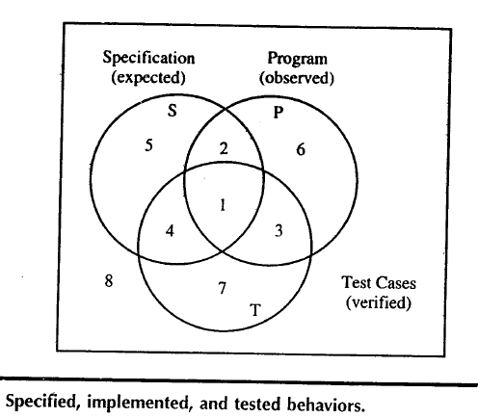
1.3

Slide 33
Discrepancy with the Universe of Discourse
There may be a slight discrepancy between the universe of discourse and the sets of program behaviors and test cases because a test case causes a program behavior.
This discrepancy is understandable, given that test cases induce program behaviors and may not perfectly align with the specified and programmed behaviors.

Slide 34
Significance of Each Region
Region 2 (Specified behaviors not tested): Incomplete testing occurs when specified behaviors exist but are not covered by test cases. This highlights the importance of ensuring comprehensive test coverage to address all specified behaviors.

Slide 35
Region 3 (Test cases covering unspecified behaviors): Several possibilities arise:
Unwarranted test case: Test cases covering behaviors not specified may be unnecessary and could lead to inefficient testing practices.
Deficient specification: The presence of test cases corresponding to unspecified behaviors may indicate deficiencies in the specification document, necessitating clarification or revision.
Tester's objective: Testers may deliberately include test cases for behaviors not specified to verify that certain non-behaviors do not occur. This practice demonstrates the importance of skilled testers in identifying potential gaps or ambiguities in the specification.

Slide 36
Involvement of Testers in Specification and Design Reviews:
Good testers often participate in specification and design reviews to contribute their insights and propose test cases, particularly those aimed at verifying non-behaviors or edge cases.
Their involvement helps improve the quality of specifications and ensures that test cases align with the intended behavior of the software.

Slide 37
Identifying Test Cases
Two Fundamental Approaches
Traditional terms: Functional testing and structural testing.
More descriptive terms: Specification-based and code-based approaches.

Slide 38
Specification-Based Approach
Focuses on testing against the specified requirements and functionality.
Test case identification methods align with the specified behavior of the software.
Code-Based Approach
Focuses on testing the implementation of the software.
Test case identification methods align with the code structure and logic.

Slide 39
Methodical Approach
Test case identification methods are generally referred to as testing methods.
These methods are systematic and methodical, ensuring consistency in test case generation.
Two testers following the same method are likely to devise very similar or equivalent test cases.
Equivalence of Test Cases
Testers following the same method may devise equivalent test cases, ensuring thorough coverage of the software's behavior and implementation.

Slide 40
Specification-Based Testing
Functional View of Programs
Programs can be viewed as functions that map inputs from their domain to outputs in their range.
This perspective is common in engineering, especially when treating systems as black boxes.

Slide 41
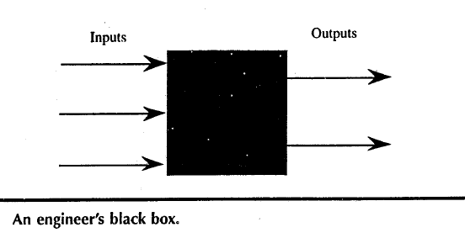
Black Box Testing
Synonymous with specification-based testing.
In black box testing, the internal implementation of the system (the "black box") is not known to the tester.
The function of the black box is understood solely in terms of its inputs and outputs.

Slide 42
Advantages:
Independence from Implementation: Test cases are solely based on the software specification, making them independent of how the software is implemented. This means that even if the implementation changes, the test cases remain relevant and useful.
Parallel Development: Test case development can occur concurrently with the implementation of the software. This parallel development approach helps in reducing the overall project development interval, leading to potentially faster time-to-market.

Slide 43
Disadvantages:
Redundancies: Specification-based test cases may suffer from significant redundancies, where multiple test cases cover similar or overlapping scenarios. This redundancy can lead to inefficiencies in testing.
Possibility of Gaps: There is a risk of gaps in test coverage, where certain aspects of the software may remain untested. This can occur due to oversight or limitations in the specification's coverage.

Slide 44
Comparison of Test Case Results
Figure 1.5 depicts the results of test cases identified by two specification-based methods, Method A and Method B.
Method A identifies a larger set of test cases compared to Method B.
Both methods generate test cases that are completely contained within the set of specified behavior.
Limitation of Specification-Based Methods
Because specification-based methods rely solely on the specified behavior, it is challenging for them to identify behaviors that are not explicitly specified.
These methods focus on testing against the specified requirements and functionality, which inherently limits their ability to identify unspecified behaviors.

Slide 45
Figure 1.5

Slide 46
1.4.2 Code-Based Testing
Fundamental Approach:
Code-based testing is another fundamental approach to test case identification.
It contrasts with black box testing and is sometimes referred to as white box or clear box testing.
White Box Testing:
White box testing emphasizes the ability to see inside the black box, referring to the knowledge of the internal implementation of the software.
Another term for white box testing is clear box testing, which may be more appropriate as it highlights the transparency of the internal implementation.

Slide 47
Theoretical Basis:
Code-based testing is grounded in strong theories, requiring familiarity with concepts such as linear graph theory for a deeper understanding.
Description of Tested Elements:
With knowledge of linear graph theory concepts, testers can rigorously describe exactly what aspects of the code are being tested.
Test Coverage Metrics:
Code-based testing facilitates the definition and use of test coverage metrics.
Test coverage metrics provide a quantitative measure of the extent to which a software item has been tested.

Slide 48
Benefits of Test Coverage Metrics:
Test coverage metrics allow for the explicit statement of the level of testing achieved.
They make testing management more meaningful by providing insights into the completeness and thoroughness of the testing process.
Management of Testing:
Test coverage metrics enable testing managers to make informed decisions about the testing process.
They help identify areas of the code that require further testing and prioritize testing efforts effectively.

Slide 49
Comparison of Test Case Results:
Figure 1.6 depicts the results of test cases identified by two code-based methods, Method A and Method B.
Method A identifies a larger set of test cases compared to Method B.
Evaluation of Test Case Quantity:
The question arises whether a larger set of test cases is necessarily better.
Code-based testing provides important ways to develop an answer to this question.

Slide 51
Containment within Programmed Behavior:
For both methods, the set of test cases is completely contained within the set of programmed behavior.
Code-based methods focus on the program itself, making it unlikely for them to identify behaviors that are not programmed.
Relative Size of Code-Based Test Cases:
It is conceivable that a set of code-based test cases is relatively small compared to the full set of programmed behaviors.
This raises considerations about the effectiveness and efficiency of code-based testing in achieving sufficient test coverage.

Slide 53
Specification-Based versus Code-Based Debate
Fundamentally Different Approaches:
Specification-based and code-based testing are two distinct approaches to test case identification.
Each approach uses different methods and criteria for identifying test cases.
Debate Over Superiority:
There is a longstanding debate in the literature about which approach is better.
Strong adherents can be found for both specification-based and code-based testing.
Resolution from Venn Diagrams:
The Venn diagrams presented provide a strong resolution to this debate.
Both approaches aim to identify test cases, but they use different bases: specification for specification-based testing and program source code (implementation) for code-based testing.

Slide 54
Insufficiency of Individual Approaches:
Neither approach alone is sufficient to ensure comprehensive test coverage.
If specified behaviors are not implemented, code-based testing will not detect this.
Conversely, if the program implements behaviors not specified, specification-based testing will not uncover them.

Slide 55
Need for a Combination Approach:
Both specification-based and code-based approaches are necessary.
A judicious combination of both approaches is advocated.
This combination provides the confidence of specification-based testing and the measurement capability of code-based testing.
Benefits of Combined Approach:
When specification-based test cases are executed in combination with code-based test coverage metrics:
Redundancies and gaps in specification-based testing can be identified and resolved.
The strengths of each approach complement each other, leading to more effective testing.

Slide 56
Relationship Between Sets T, S, and P:
The Venn diagram view of testing illustrates the relationship between the sets of test cases (T), specified behaviors (S), and implemented behaviors (P).
Test cases in set T are determined by the test case identification method used.
Appropriateness and Effectiveness of Test Case Identification Method:
The appropriateness or effectiveness of the test case identification method used is a crucial consideration.
It determines the quality and coverage of the test cases generated.

Slide 57
Causal Trail from Error to Incident:
Recalling the causal trail from error to fault, failure, and incident, understanding the types of errors and faults is essential.
Knowledge of potential errors and faults helps in employing more appropriate test case identification methods.
Testing as a Craft:
The ability to select and apply the most suitable test case identification methods based on the nature of errors and faults reflects the craft of testing.
Testing transcends mere methodology and becomes an art form that requires skill, experience, and intuition.

Slide 58
Fault Taxonomies
Definition of Error and Fault:
Error refers to a mistake made in the process, while fault is the manifestation of that error in the product.
Process relates to how something is done, while product is the end result of the process.
Testing and Software Quality Assurance (SQA):
Testing is more product-oriented, focused on discovering faults in the product.
SQA aims to improve the product by enhancing the development process to reduce errors.
Product Orientation of Testing:
Testing is primarily concerned with identifying faults in the product.
It focuses on evaluating the product's behavior and functionality to uncover defects.

Slide 59
Process Improvement in SQA:
SQA focuses on improving the development process to prevent errors from occurring in the product.
By enhancing the process, SQA aims to minimize the occurrence of faults and improve overall software quality.
Classification of Faults:
Faults can be classified based on various criteria, such as the development phase where the error occurred, consequences of corresponding failures, difficulty to resolve, and risk of no resolution.
An alternative classification method is based on anomaly occurrence: one-time-only, intermittent, recurring, or repeatable.
Importance of Clear Definitions:
Both testing and SQA benefit from clear definitions of types of faults.
Clear classification helps in understanding and addressing different types of faults effectively.

Slide 60
IEEE Standard Classification for Software Anomalies and fault classifications:
IEEE Standard Classification for Software Anomalies:
The IEEE Standard Classification for Software Anomalies provides a comprehensive treatment of different types of faults.
An anomaly, as defined in the document, is "a departure from the expected."
Anomaly Resolution Process:
The IEEE standard outlines a detailed anomaly resolution process consisting of four phases: recognition, investigation, action, and disposition.
This process forms another life cycle in software development aimed at identifying, investigating, addressing, and resolving anomalies.
Useful Anomalies:
Tables 1.1 through 1.5 in the IEEE standard present various useful anomalies categorized based on their characteristics and impact.
These anomalies serve as reference points for identifying and addressing faults during the software development lifecycle.

Slide 61
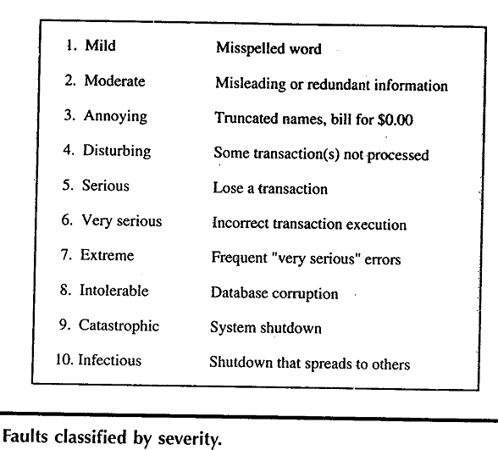
Tables 1.1

Slide 62
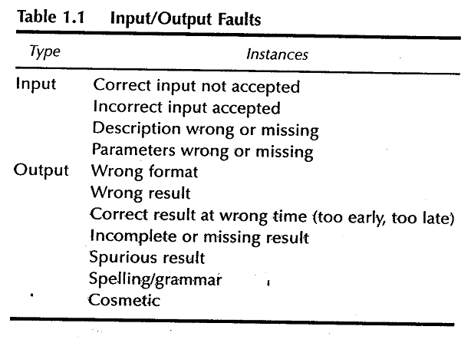
Tables 1.2

Slide 63
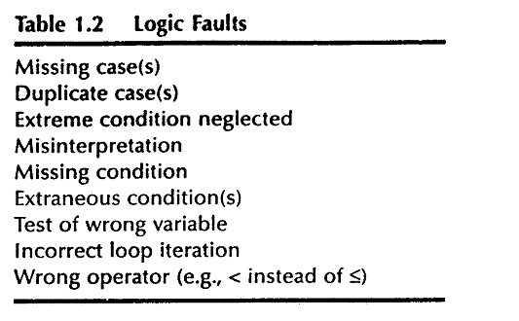
Tables 1.3

Slide 64
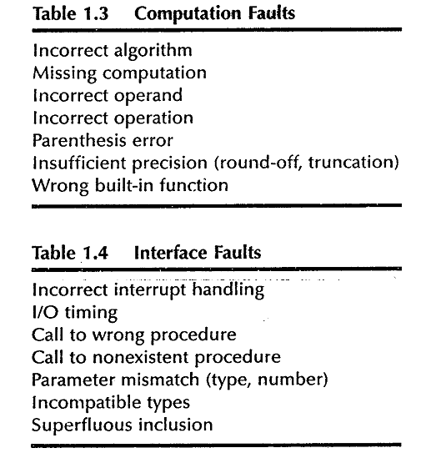
Tables 1.4

Slide 65
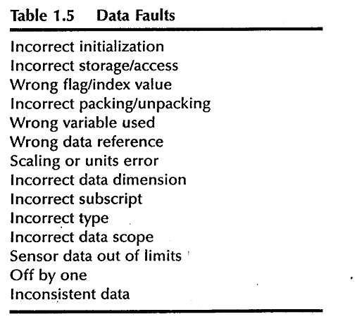
Tables 1.5

Slide 66
Software Review Checklists:
Software reviews are essential for identifying faults in software artifacts.
Review checklists, such as those provided by Karl Wiegers on his website, offer another source of fault classifications and guidelines for conducting effective reviews.
Importance of Fault Classifications:
Fault classifications provided by the IEEE standard and review checklists aid in systematically identifying, categorizing, and addressing different types of faults.
They serve as valuable tools for improving software quality, enhancing development processes, and mitigating risks.

Slide 67
Levels of Testing
Levels of Abstraction in Testing:
Levels of testing correspond to levels of abstraction found in the waterfall model of the software development life cycle.
The waterfall model, despite its drawbacks, serves as a useful framework for identifying distinct levels of testing and clarifying their objectives.
The V-Model:
A diagrammatic variation of the waterfall model, known as the V-Model, emphasizes the correspondence between testing and design levels.
The V-Model illustrates how different levels of testing align with different stages of software design, including specification, preliminary design, and detailed design.

Slide 68
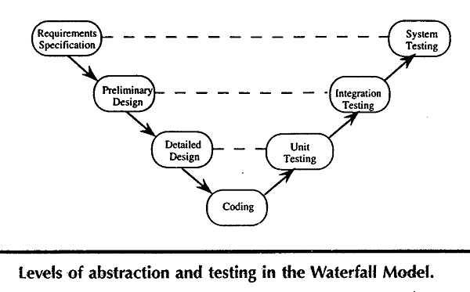
Figure :1.8

Slide 69
Correspondence between Testing Levels and Design Levels:
In terms of specification-based testing, the three levels of definition (specification, preliminary design, and detailed design) directly correspond to three levels of testing—system, integration, and unit testing.
Relationship with Specification-Based and Code-Based Testing:
Most practitioners agree that code-based testing is most appropriate at the unit level, while specification-based testing is most appropriate at the system level.
This relationship is partly influenced by the information produced during the requirements specification, preliminary design, and detailed design phases.
Development of Testing Structures:
Constructs defined for code-based testing are typically suitable for the unit level.
Efforts are underway to develop similar constructs for integration and system levels of testing, both for traditional and object-oriented software.

Slide 70
Examples
Three examples to illustrate various unit Testing methods.
These examples raise most of the issues that testing craftsperson's will encounter at the unit level.
For the purpose of structural testing, pseudocode implementation of 3 unit-level eg. are given.
The triangle problem
NextDate
Commission problem

Slide 71
Generalized Psuedocode
Pseudocode provides a “language neutral” way to express program source code.
Pseudocode given here is based on visual basic.

Slide 72
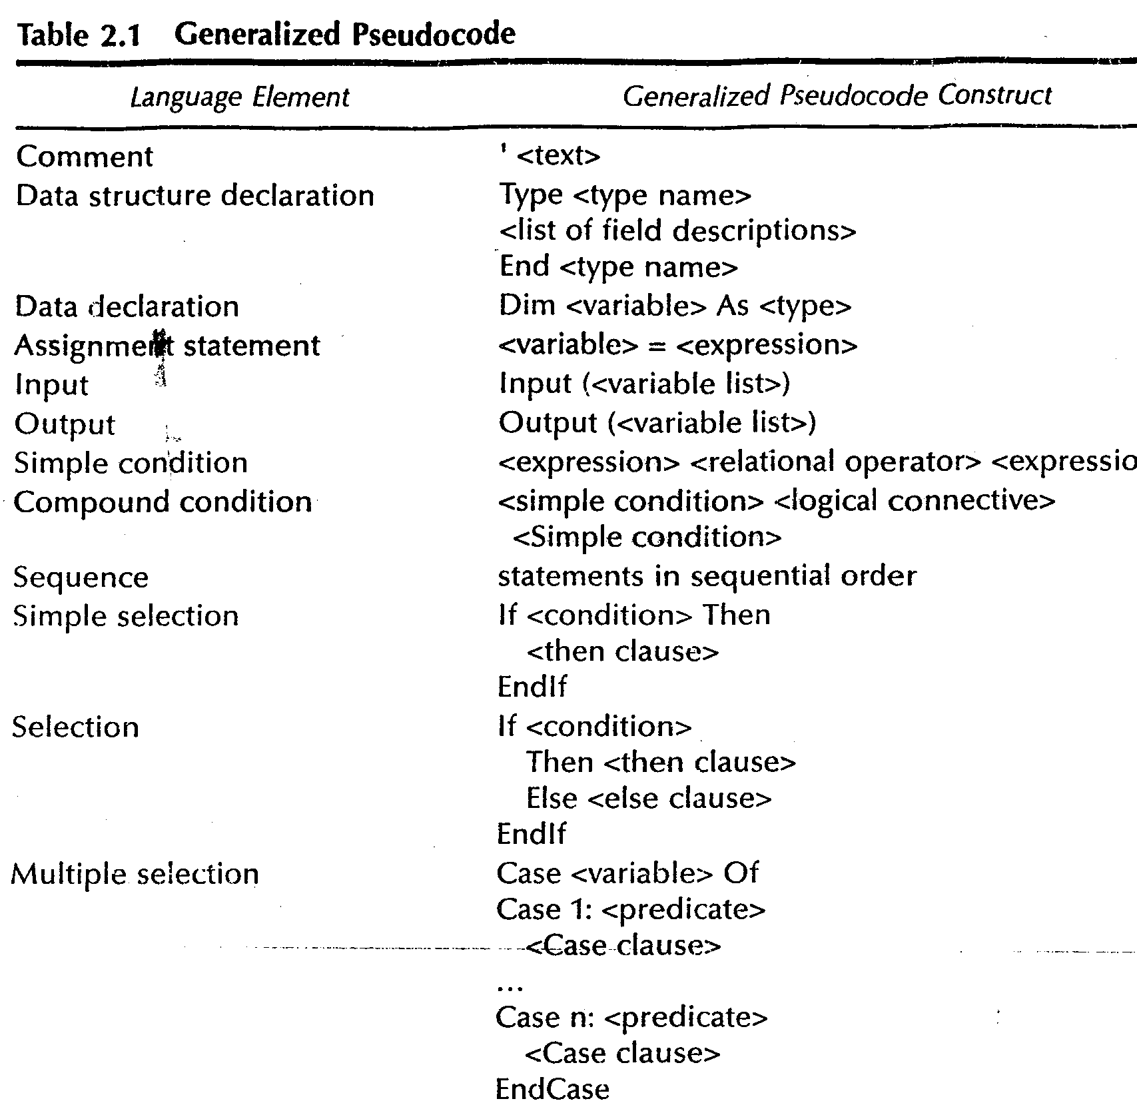

Slide 73
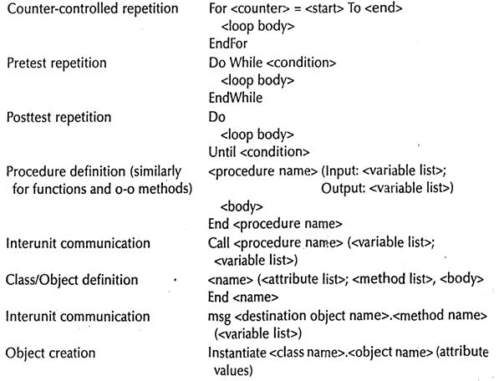

Slide 74
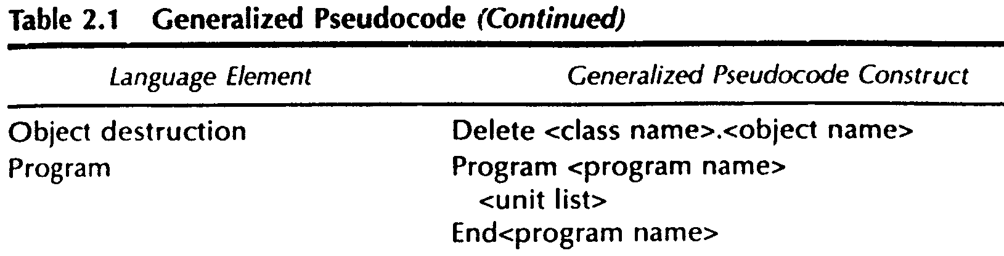

Slide 75
Triangle Problem
Problem statement
Simple version: The triangle program accepts 3 integers a, b, c as input to be sides of a triangle
o/p is type of triangle determined by 3 sides
Equilateral, Isosceles, Scalene, Not a triangle.

Slide 76
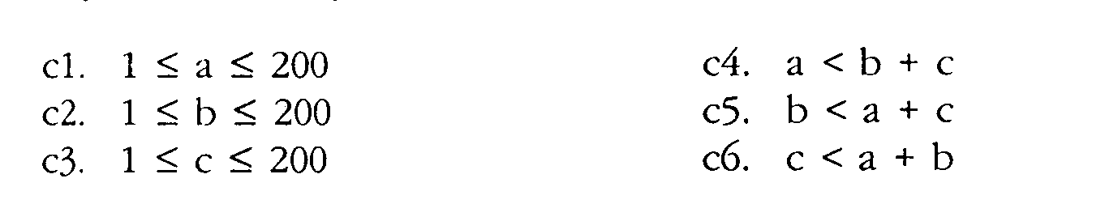
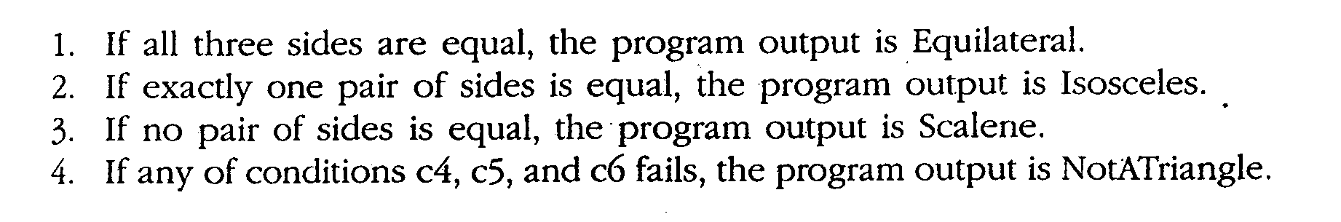
Improved version
Sides of triangle integer a, b, c must satisfy the following conditions
One of the 4 mutually exclusive output is given

Slide 77
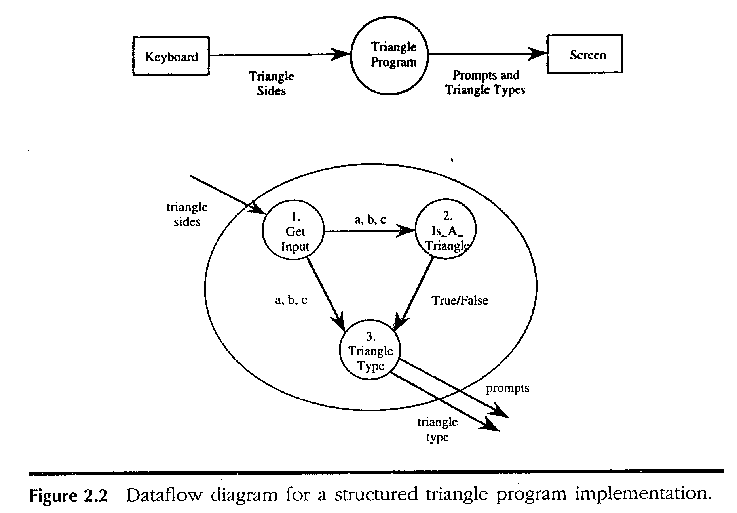

Slide 78
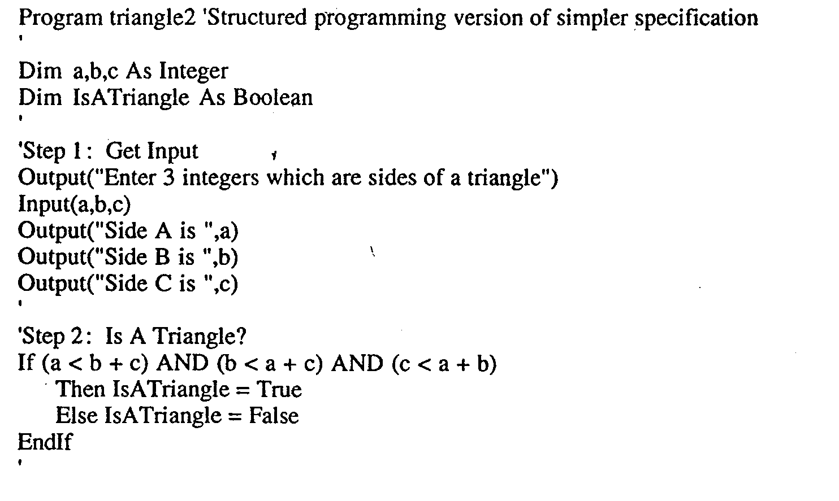

Slide 79
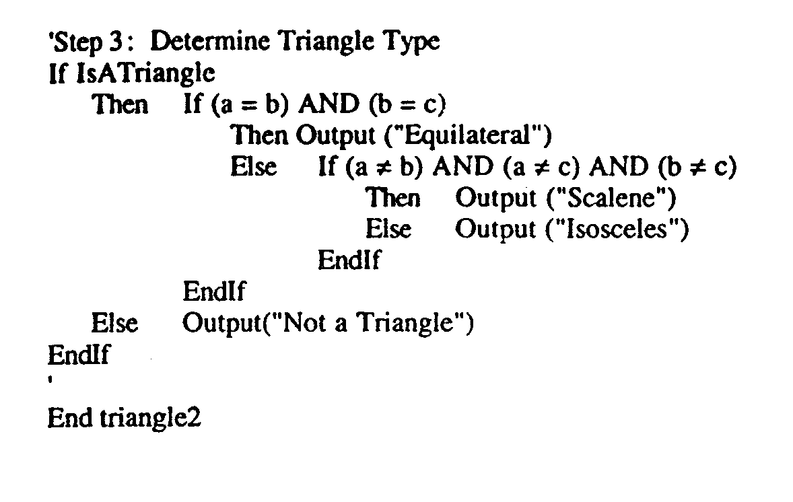

Slide 80
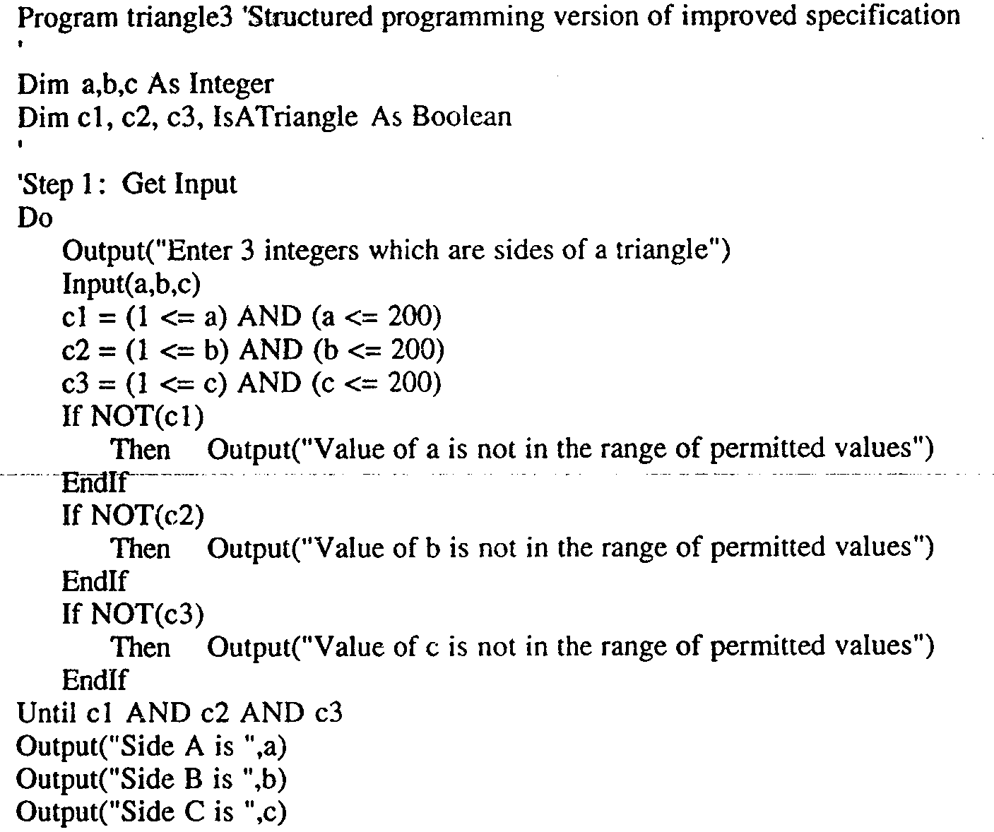

Slide 81
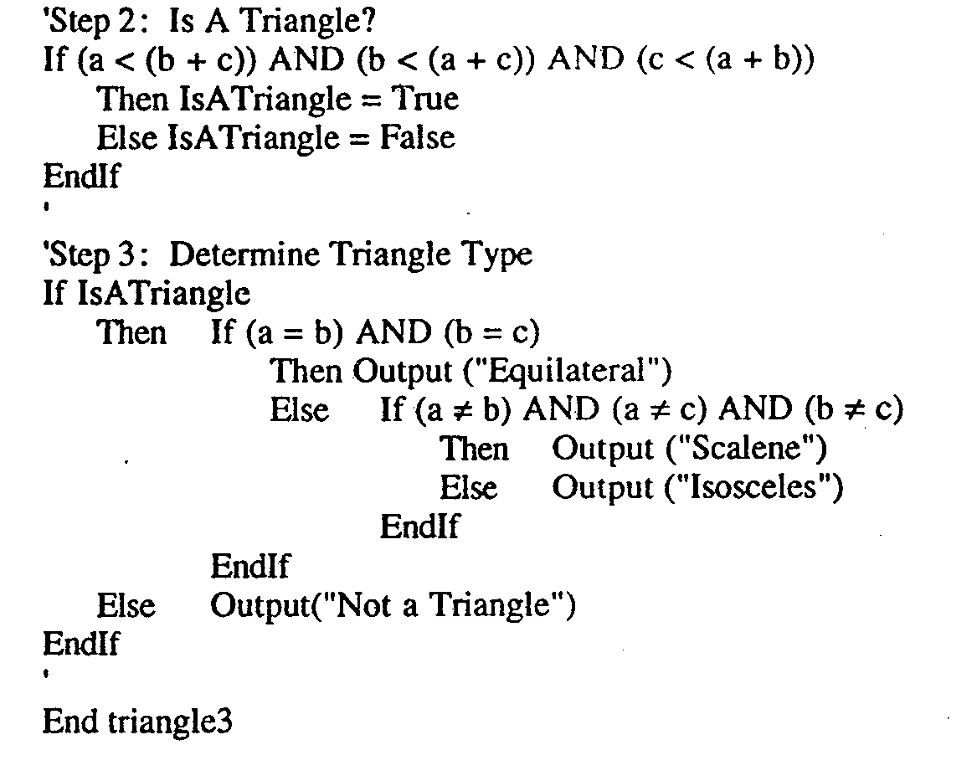

Slide 82
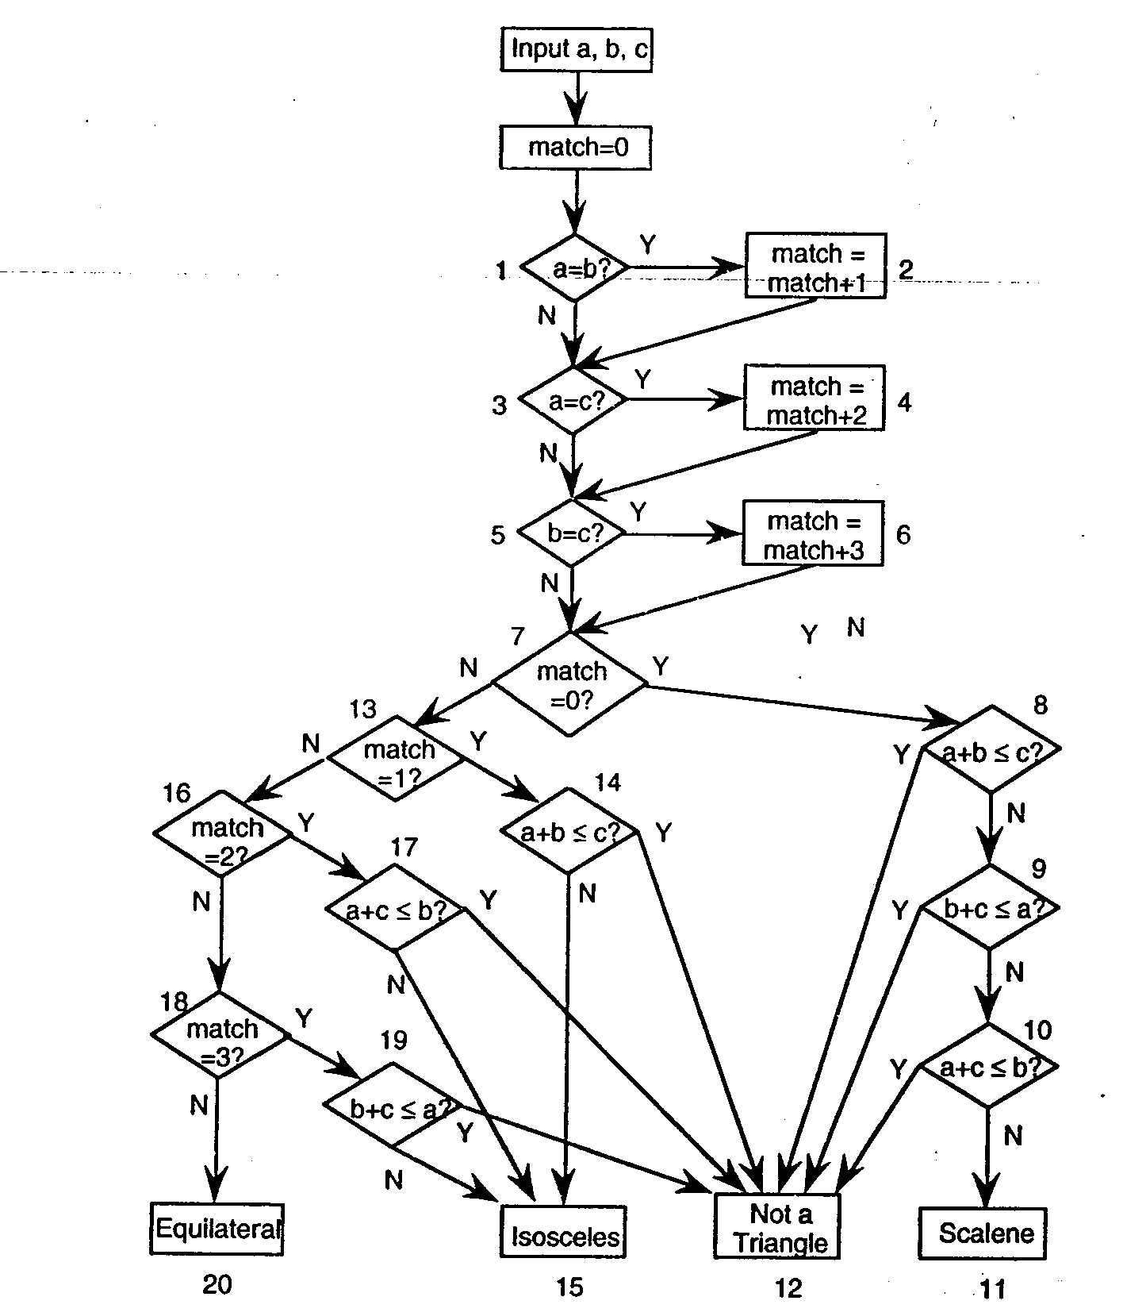
Traditional Implementation

Slide 83
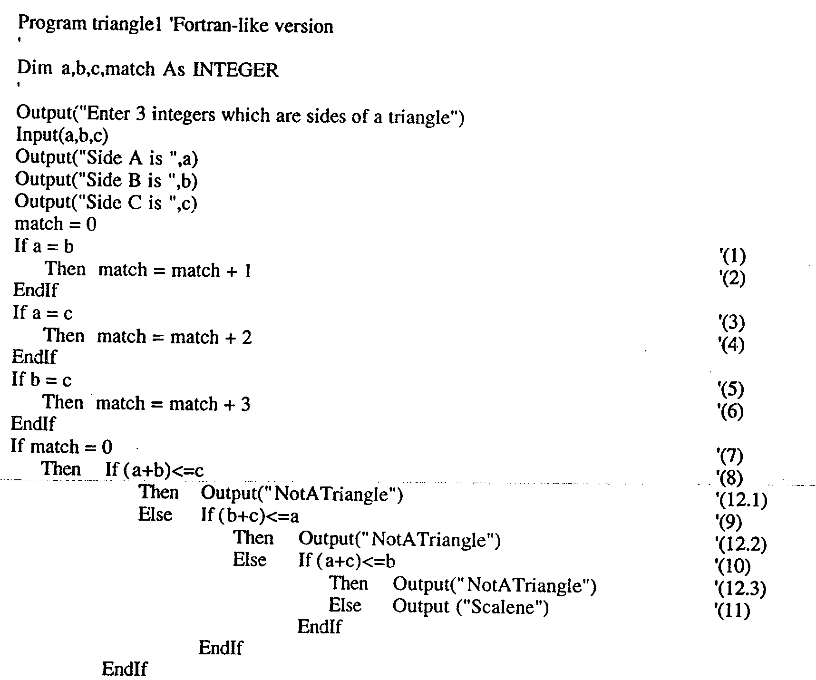

Slide 84
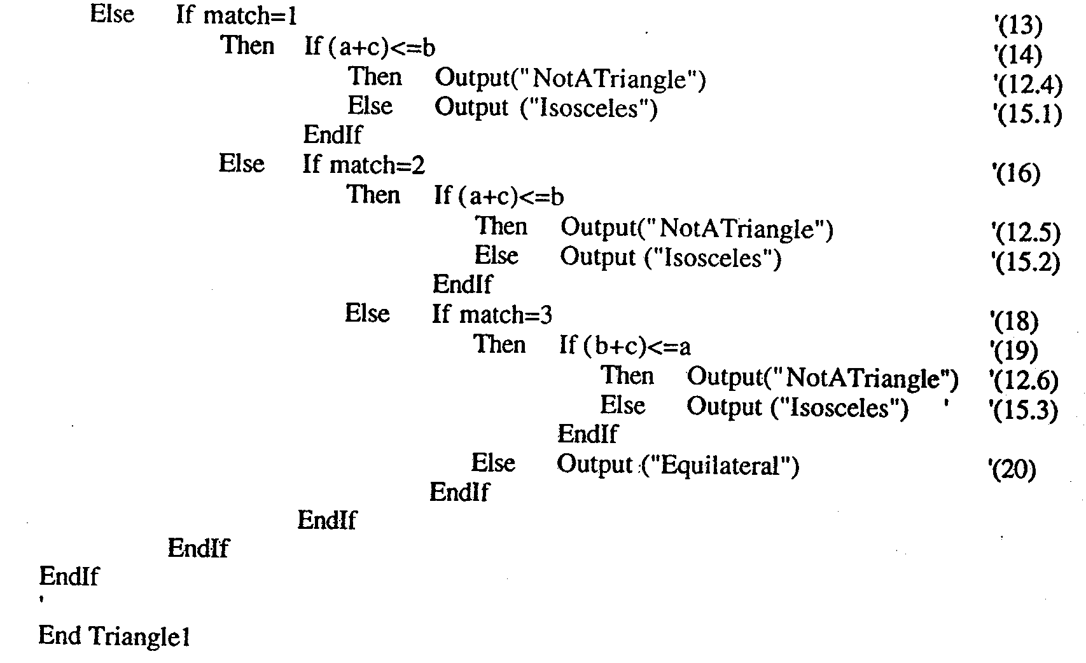

Slide 85
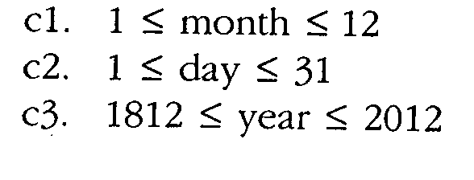
The NextDate Function
Illustrate complexity
Logical relationship among the i/p variables
Problem statement:
NextDate is a function of 3 variables Month, Day, Year.
It returns the date of the day after the i/p date.
condition

Slide 86
Problem statement
Responses for invalid values of i/p values for day, month, year.
Responses for invalid combination of i/p june 31 any year.
If any of the conditions C1, C2, or C3 fails
Corresponding variables has out-of-range values.
Eg. “Value of month not in range 1…12”
If invalid day-month- year combination exist NextDate collapses these into one message
“Invalid input date”

Slide 87
Discussion
Two source of complexity
Complexity of input domain
Rule that determine when a year is leap year.
A year is 365.2422 days long
Leap years are used for the “extra day” problem.
According to Gregorian calendar
A year is a leap year if it is divisible by 4, unless it is a century year.
Century years are leap years only if they are multiples of 400
So 1992, 1996, 2000 are leap years… 1900 is not

Slide 88
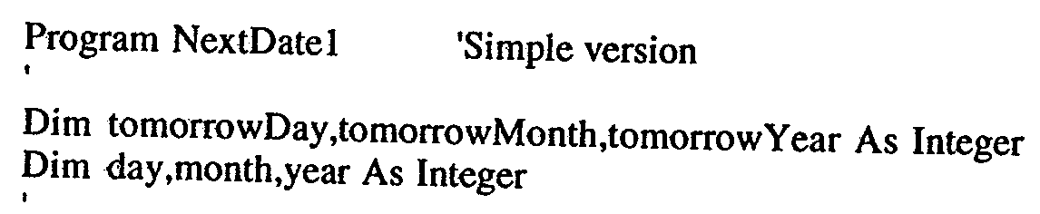
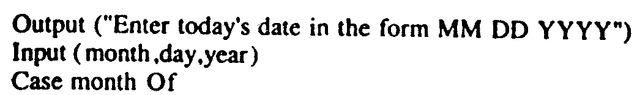
Implementation

Slide 89
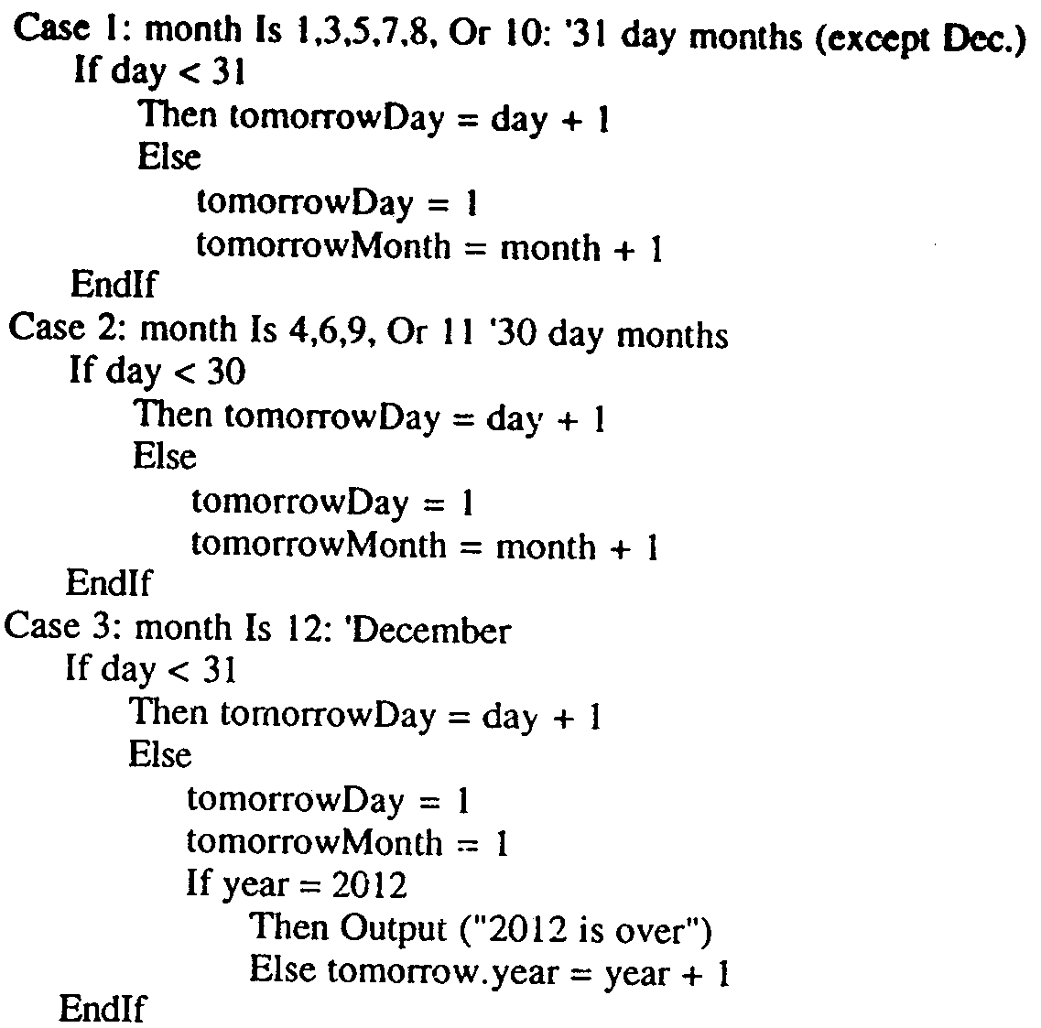

Slide 90
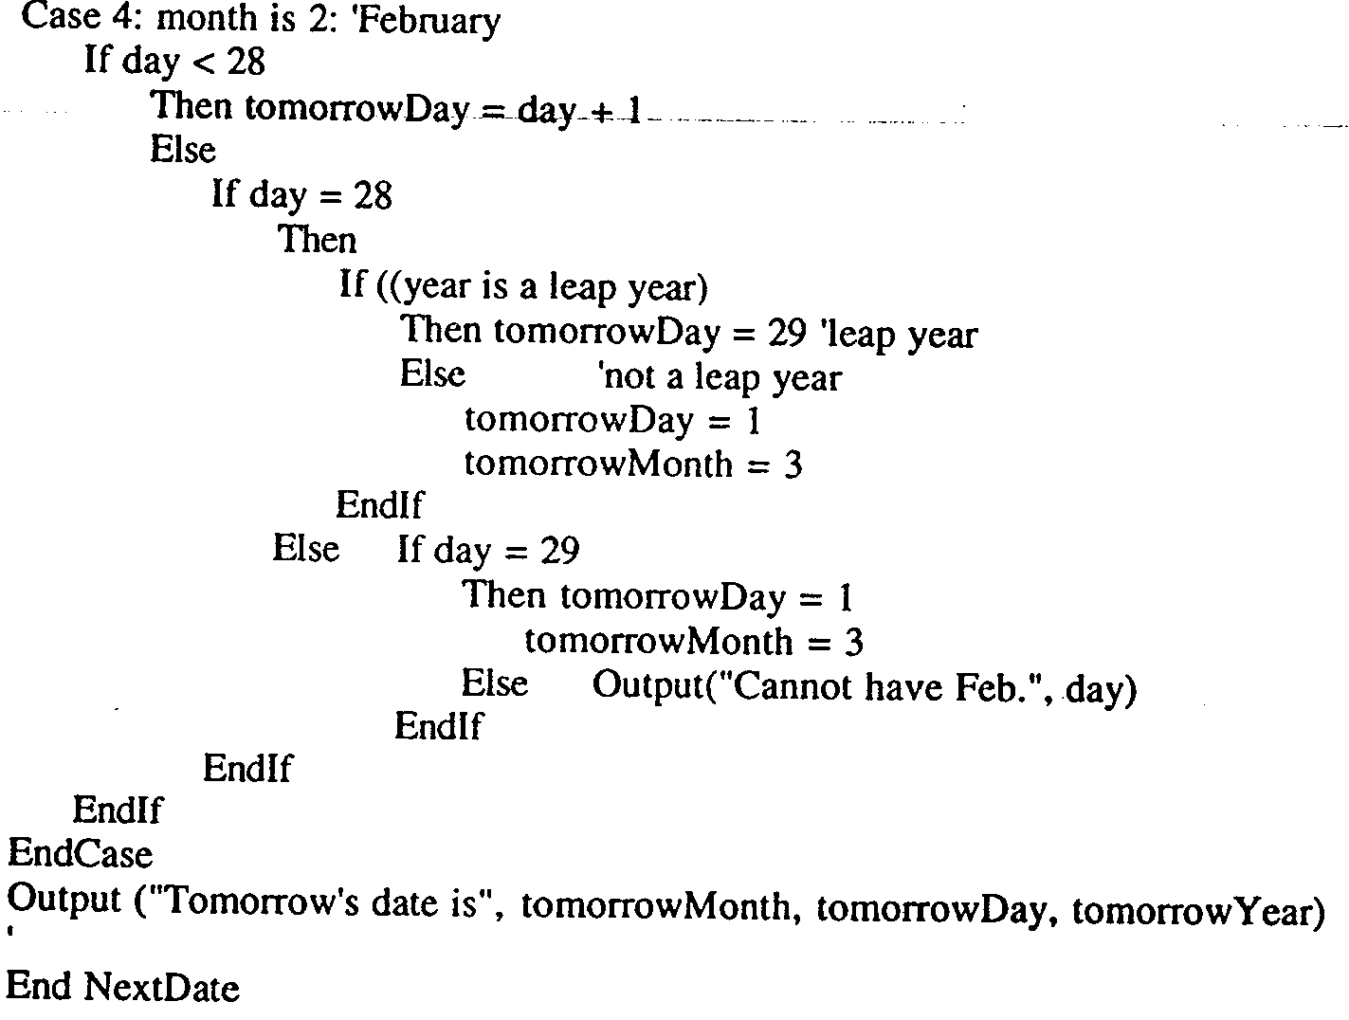

Slide 91
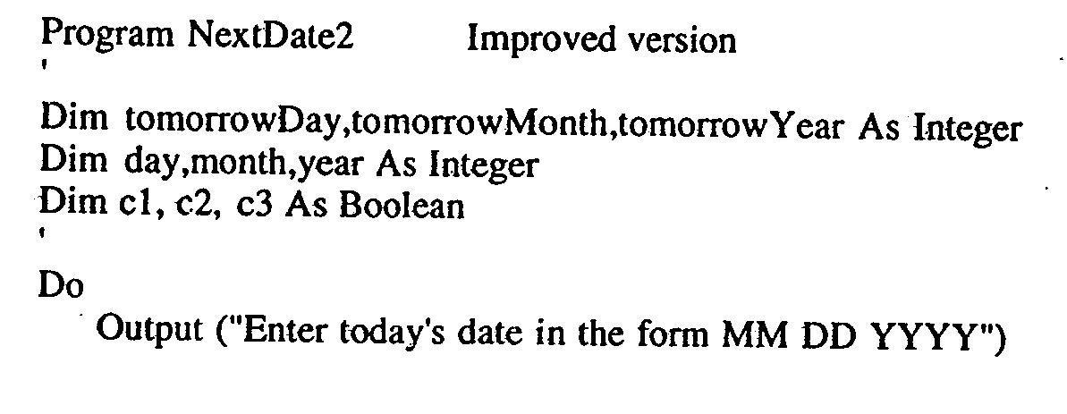
Improved Version

Slide 92
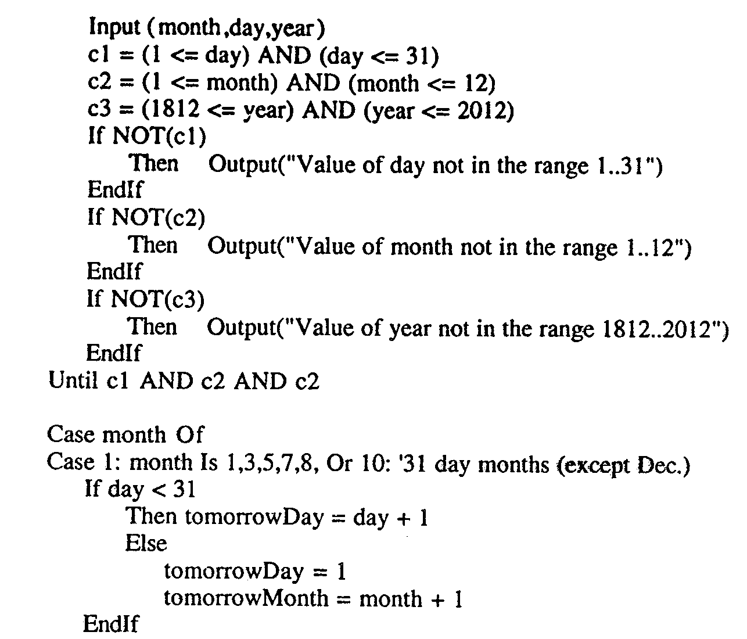

Slide 93
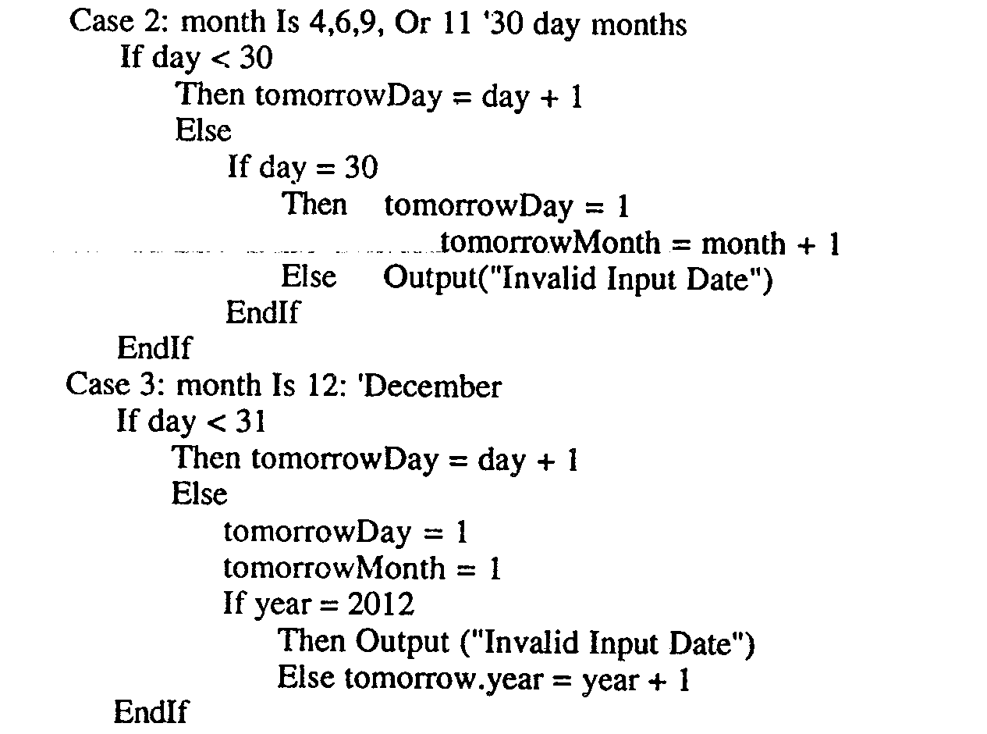

Slide 94
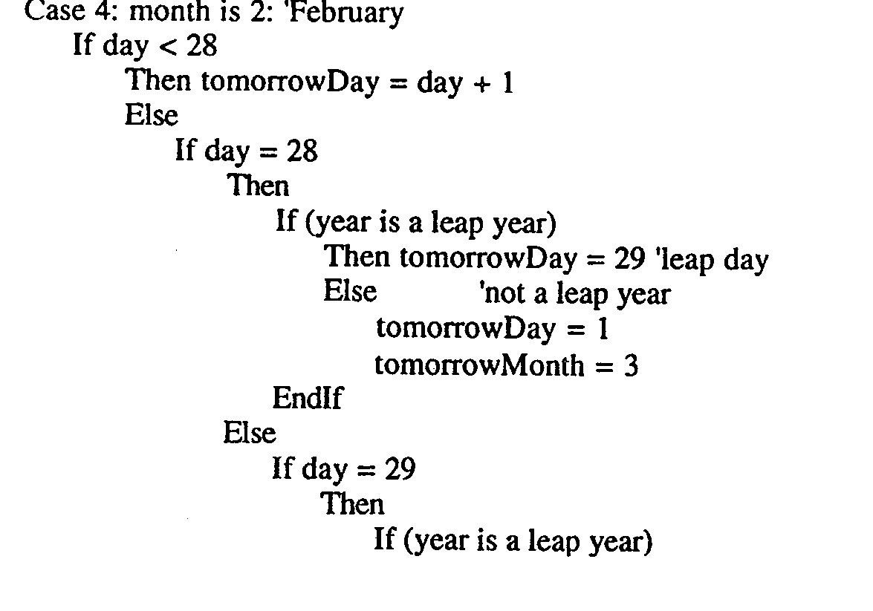

Slide 95
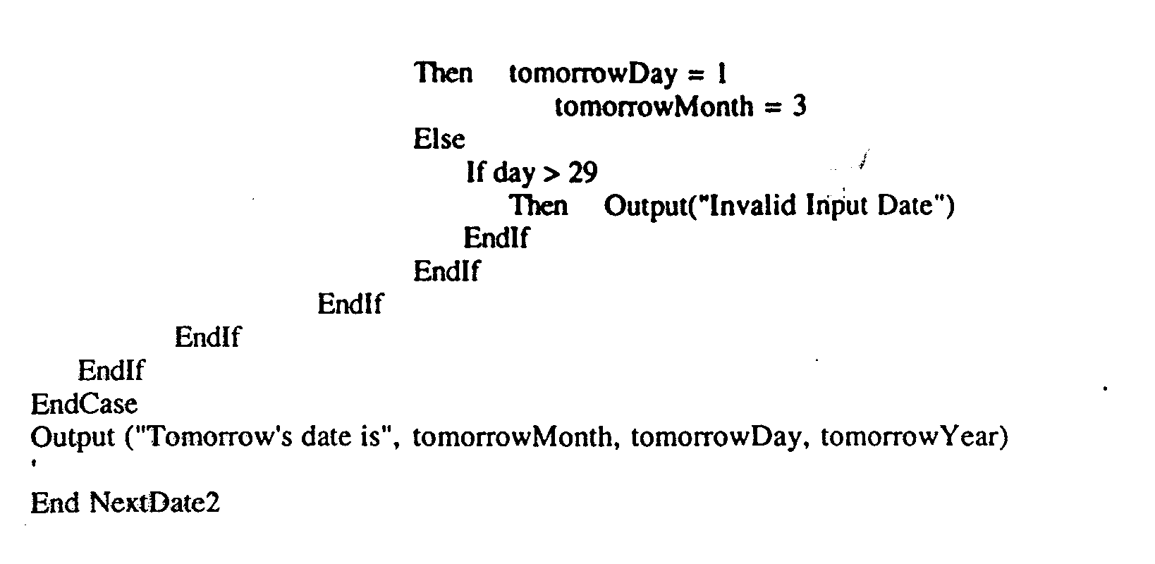

Slide 96
The commission Problem
It contains a mix of computation & decision making.
A rifle salesperson in the former Arizona territory sold rifle lock’s, stocks, & barrel’s made of a gunsmith in Missouri.
Locks cost $45, stocks cost $30, Barrel Cost $ 25.
Sales person has to sell at least 1 complete rifle per month
Production limitation such that 1 sales man can sell 70 locks, 80 stocks, 90 barrels per month.

Slide 97
After each town visit salesperson update sale of no of locks, stocks, barrels through a telegram to gunsmith
At the end of month salesperson sent a shot telegram showing -1 locks sold.
Gunman knew sales for month are over & compute the commission of sales person
10% on sales up to $1000
15% on the next $800
20% on any sales in excess of $1800
The commission program produces a monthly sales report that gave total no. of locks, barrels, stocks sold. Sales persons total dollar sale & commission.

Slide 98
Discussion
This problem separates into 3 distinct pieces
The input data portion( data validation) ignore here
Sales calculation Commission calculation problem.

Slide 99
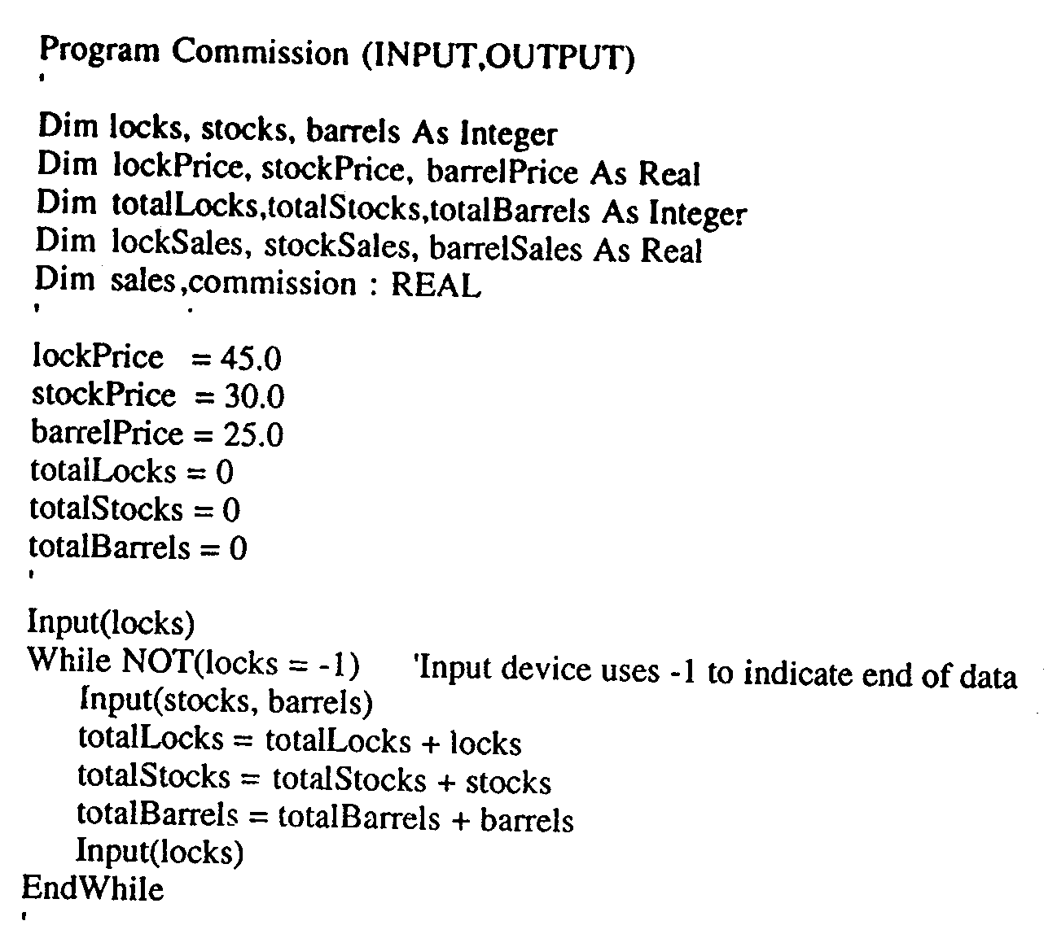
Implementation

Slide 100
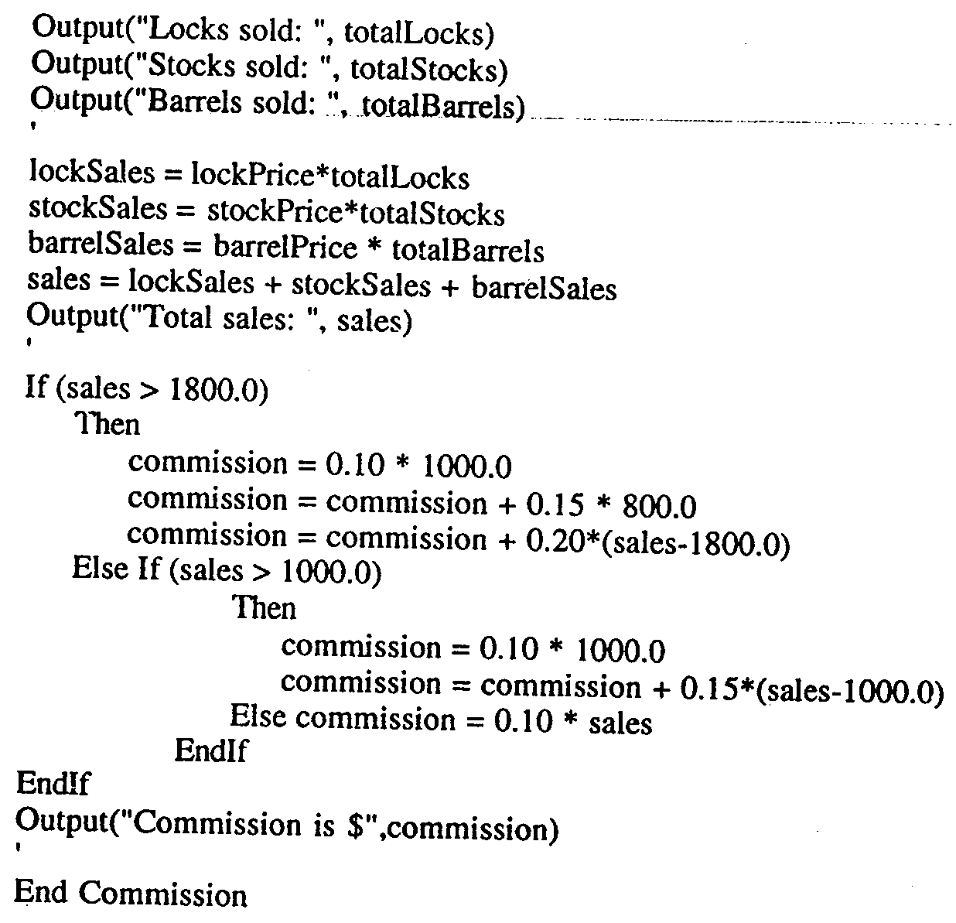

Slide 101
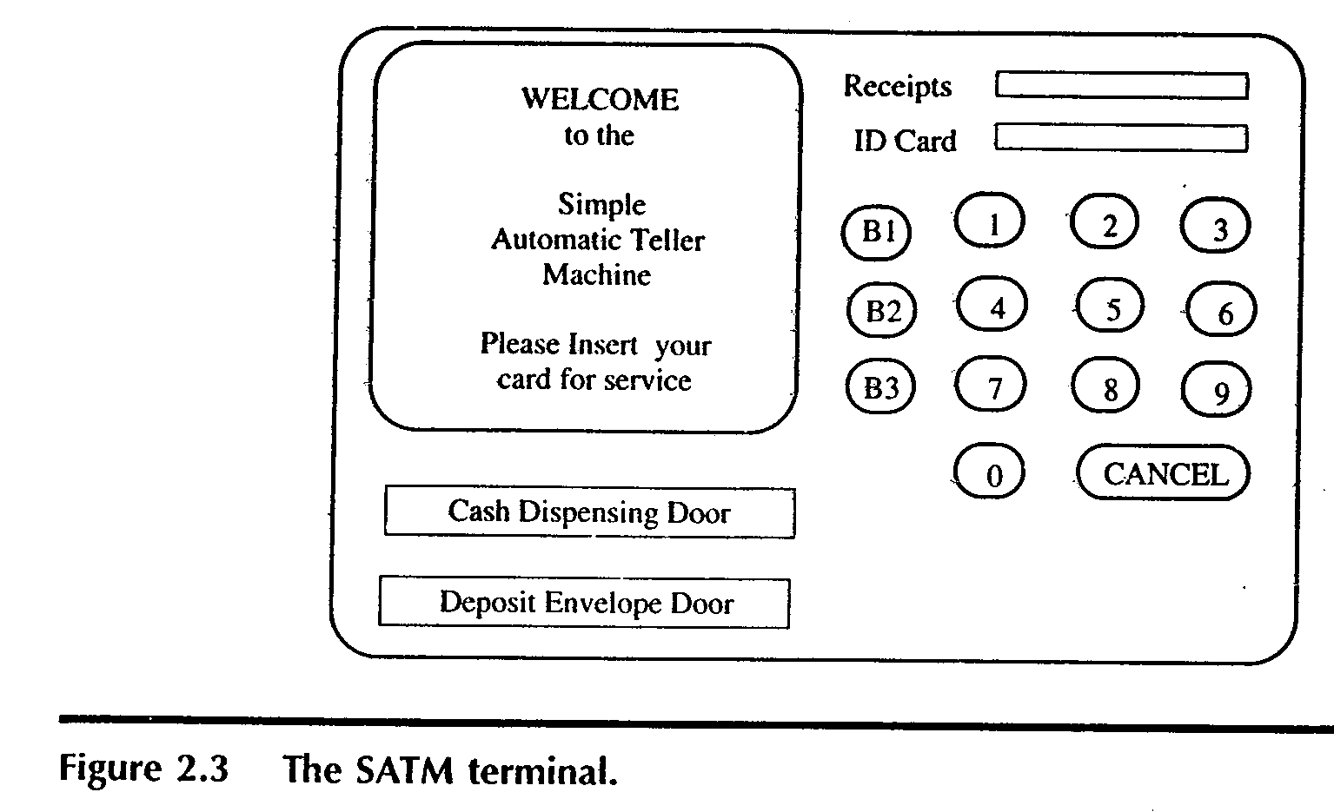
The SATM System
To better discuss the issues of integration & system testing

Slide 102
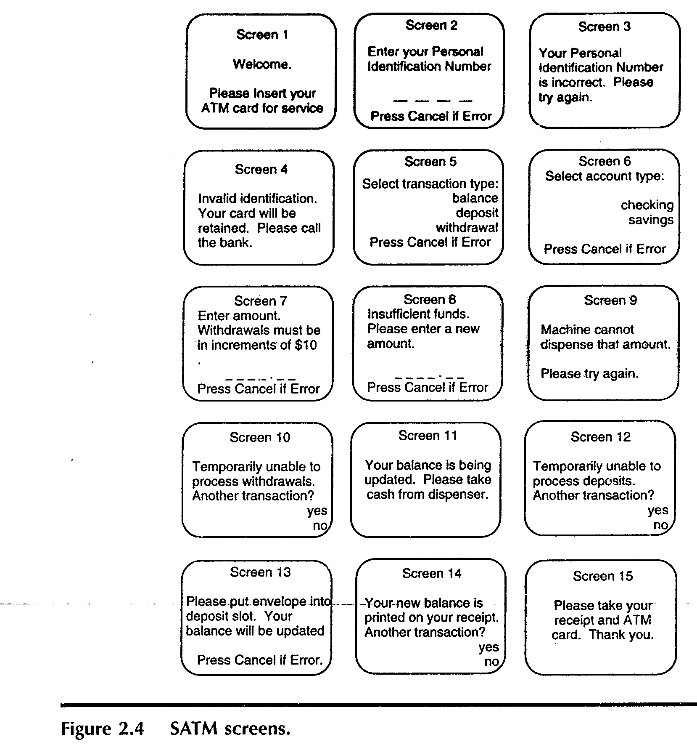

Slide 103
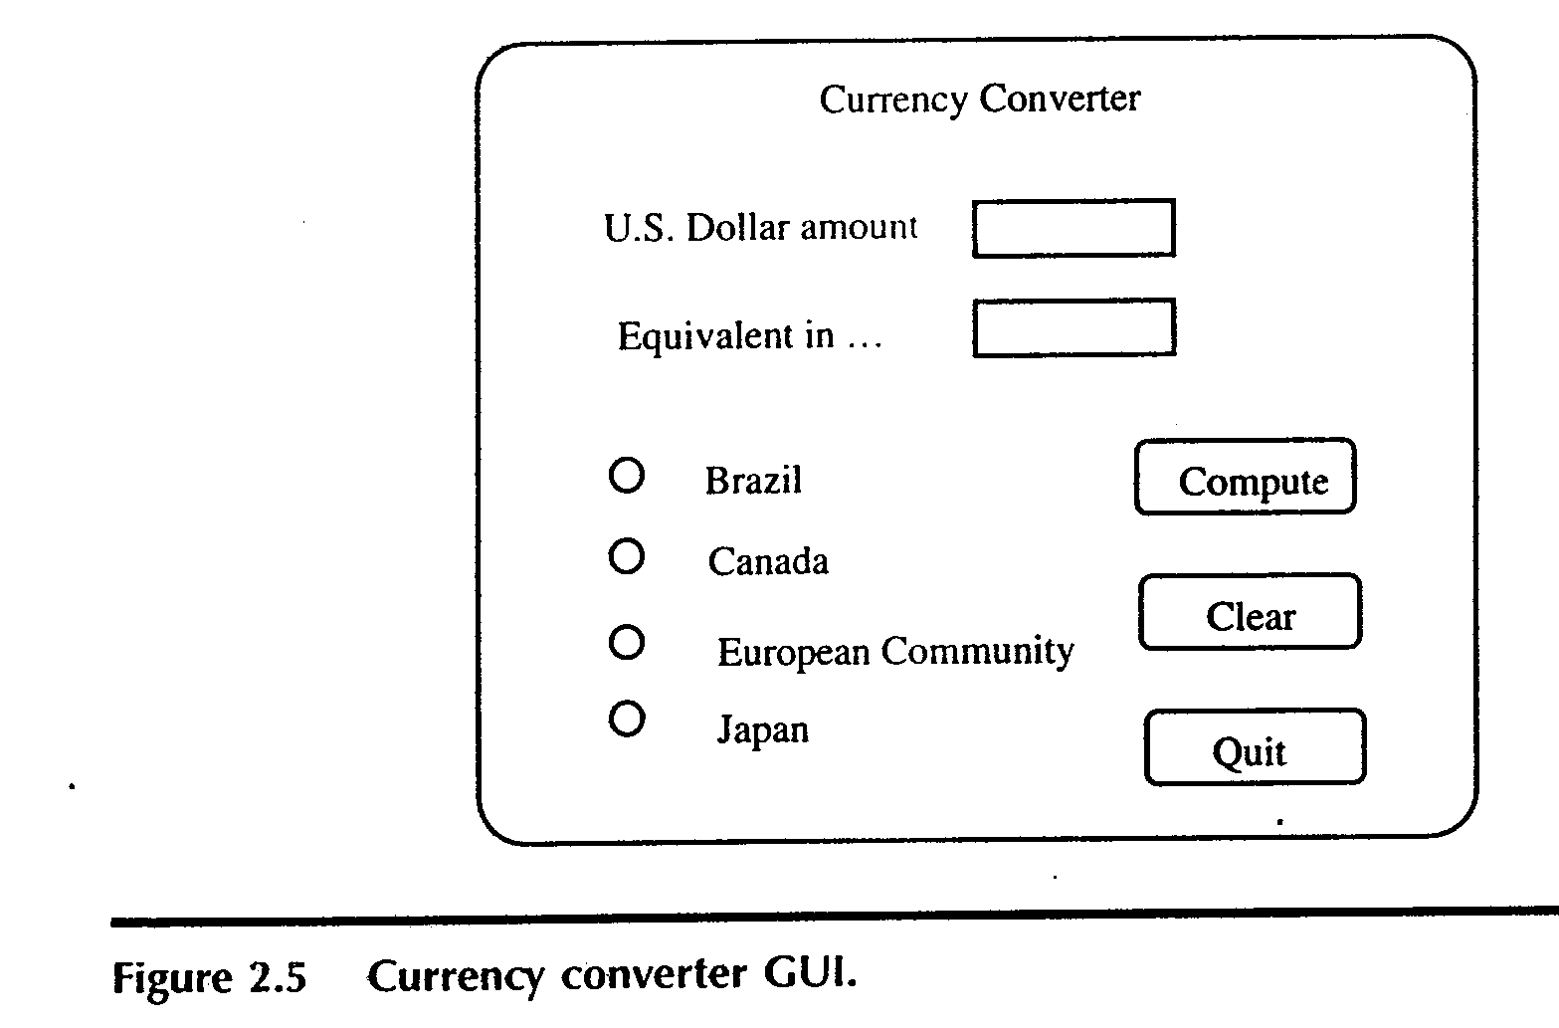
The currency converter
Another event driven program that emphasizes code associated with a GUI
A sample GUI built with visual basic is shown.

Slide 104
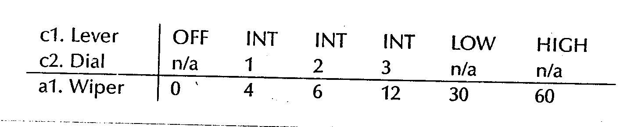
Saturn Windshield Wiper Controller

Slide 105


